Slide 1
Self Publishing Know How
NonFiction Writers Association
July 2, 2020
Notes:
Presentation title slide

Slide 2
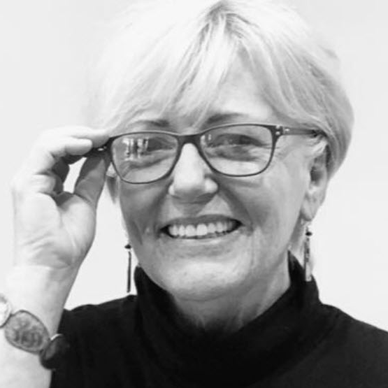
ROBIN CUTLER
Director of IngramSpark
Former Board Member, IBPA
Manager at Amazon/Createspace
Executive Director of University Relations/Univ of Wisconsin
CEO/Founder Summerhouse Press
Assistant Director of USC Press
Notes:
Presenter slide

Slide 3
Indie Publishing Evolution
Traditional—stable for hundreds of years until 2000
  Publishers as gatekeepers
  Very few authors got published
  Publisher paid for everything and made all decisions
  Slow to market—18 months to 2 years
  Slow to be paid
  Indie
  What’s the Internet? (1993) EB Online
  Rise of Amazon—decline of booksellers and publishers
  Improvements in POD/distribution
  Rise of Indie booksellers, publishers and authors
  Quick to market, author making decisions
Notes:
General content slide

Slide 4
Traditional publishing
Author submits proposal or manuscript to agents
Agents submit to publisher
If accepted, publisher offers contract to author
  assignment of rights
  Digital, audio, serialization, translation etc
  Rev share with author called royalties
  Publisher invests in editing, design, marketing, distribution
  Publisher makes decisions regarding, design publication dates, pricing
  Publisher pays author % for each book sold—typically once/year
Notes:
General content slide

Slide 5
Indie publishing
No gatekeeper (agent or publisher)
Author retains all rights
  Author invests in editing, design, marketing, distribution
  Author makes decisions regarding publication dates, pricing
  Author should invest in professionals to help navigate
  Author earns all net revenue
  Indie published can lead to traditional publishing deal
Notes:
General content slide

Slide 6
Rise of the Hybrid Author
May traditionally publish some books
Indie publish other titles
Advantage is that author has publisher to help build their author brand, etc and bear the investment
Indie published titles can come quicker to market
  Example: Timber Hawkeye
  Buddhist Bootcamp (Harper Collins)
  Faithfully Religionless (Hawkeye Publishing)
  Now publishing other authors
Notes:
General content slide

Slide 7
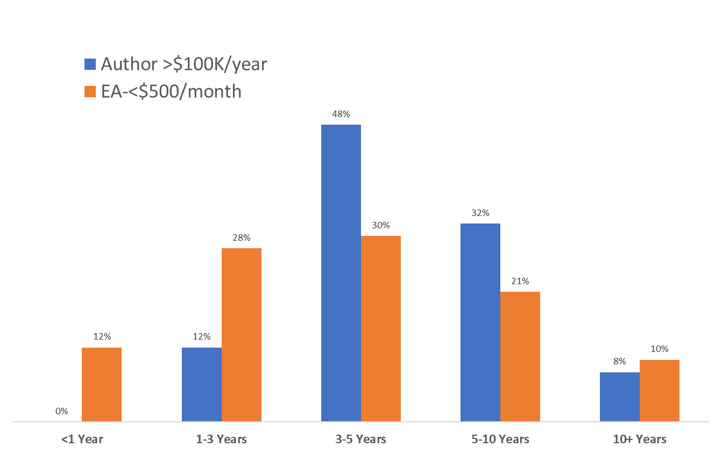
Indie Success—Takes Years
Notes:
General content slide

Slide 8
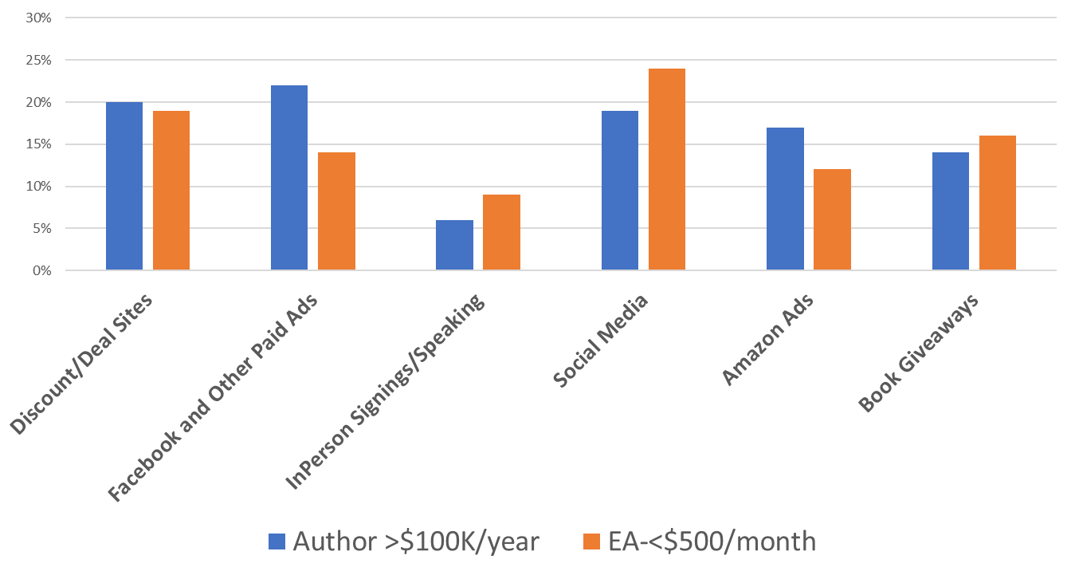
Indie Success--Takes Investment
Notes:
General content slide

Slide 9
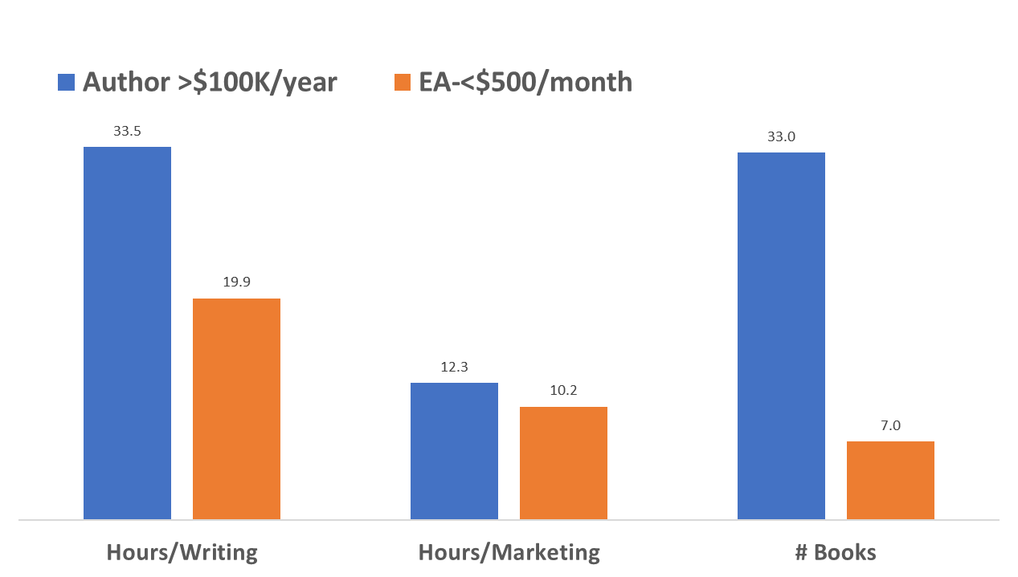
Indie Success—Takes Time
Notes:
General content slide

Slide 10
What Successful Indies Do
Think of their writing as a way to earn a living
Market themselves as a brand online and in person
Have the basic marketing tools (website, social sites, reader platforms, email management, blogs
Network: at events, conferences
Become experts in their field
Seize media opportunities
Pursue Reviews and Awards
Don’t get discouraged by rejection
Notes:
General content slide

Slide 11
Self Publishing Trends in the time of Covid
Ingram/LS/IngramSpark--essential business
Print dominance
Ebook slight rise
How much longer things take (Plan ahead)
Business is booming for self-publishers
Catalog Integrity—what this means for journals, public domain, trending topics (Covid, Pandemic)
• Direct selling
  Bookshop.org; Aerio; Shopify
Notes:
General content slide

Slide 12
What’s selling in the time of Covid
Children’s activity books
Children’s picture books
Lifestyle: cooking, fitness
Diversity—especially Black literature and culture
True Crime
Fiction—historical, Gothic romance, mythology-based
Christian
Classic poetry
Notes:
General content slide

Slide 13
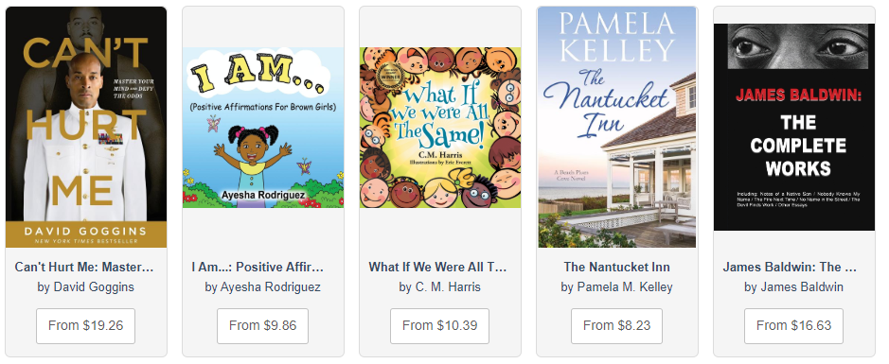
Top 10 Current Best-Sellers
Notes:
General content slide

Slide 14
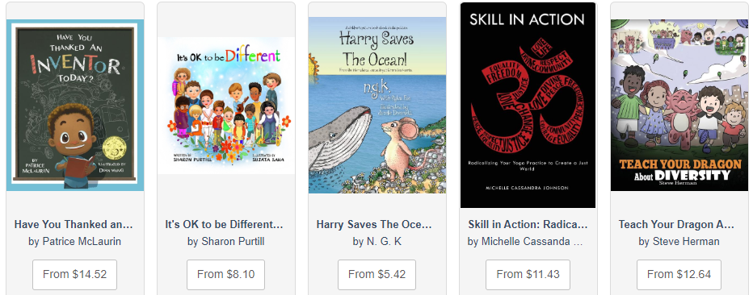

Slide 15
What is Ingram?
GLOBAL Wholesaler/Distributor of Books
World Leader in POD Technologies = Lightning Source
CONTENT PROVIDERS
Authors
Publishers
⇨
⇦
TRADE
Online
Bookstores
Libraries
Consumers
30,000 TRADITIONAL
100,000+ INDIES
14 Million+ Titles
40,000+
Notes:
General content slide

Slide 16
Ingram’s Market Access
40,000 channel partners for print and ebook
Internet Retailers (Amazon.com, Target, Walmart etc)
Big Box (Target, Walmart, Cosco etc)
Regional Chain Bookstore (B&N)
Independent Retailers
Specialty Wholesale (Spring Arbor—Christian stores)
University Bookshops
Gift stores
Museum Shops
Public and School Libraries
Notes:
General content slide

Slide 17
Distribution = Reaching Readers
Author Direct Selling
  Author Website
  Social Media/Shopify or other direct selling app
  Expert Speaking, Events
Wholesale Distribution
  Passive selling to the book trade (brick and mortar stores, online stores, libraries
Full Service Distribution
  Active selling to the book trade (brick and mortar stores, online stores, libraries
Notes:
General content slide

Slide 18
Ingram’s Distribution Services
Wholesale Distribution
Content is made available to the trade through data feeds
Provides transactions/services between trade and content providers
Nonexclusive
No active selling
Full Distribution (IPS, Two Rivers, Consortium)
Content is exclusively presented and made available to the trade
Active selling through a sales force
Services offered like royalty management, fulfillment, warehousing, content consolidation (book + plush toy)
Need sales history to enter
Notes:
General content slide

Slide 19
What to KNOW about Wholesale
Distribution takes some time, depending on the distribution partner
YOU still have to market your book so people know where to buy
You tell retailers/libraries your book is available from Ingram
Retailers and libraries prefer to order from Ingram
Ingram is not directly selling your book into stores
Changes to metadata, like pricing, are sent out in our data feeds but it’s up to our channel partners to update their sites
Notes:
General content slide

Slide 20
Why POD Makes Sense
No inventory to manage—print as you need reduces financial risk
No warehousing costs
No guesswork regarding potential demand
No orders to pack and ship
Access to global distribution/retailer markets
Can revise at any time
Fast turnaround
Notes:
General content slide

Slide 21
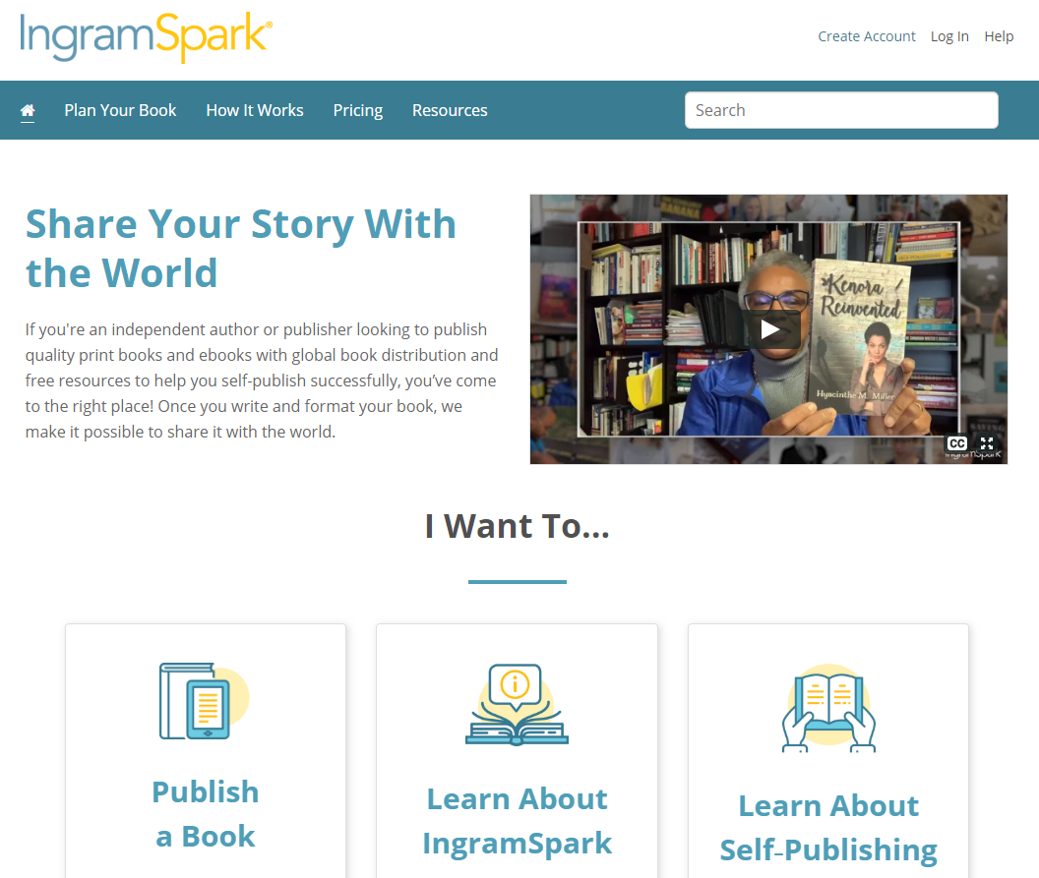
What is IngramSpark
Notes:
General content slide

Slide 22
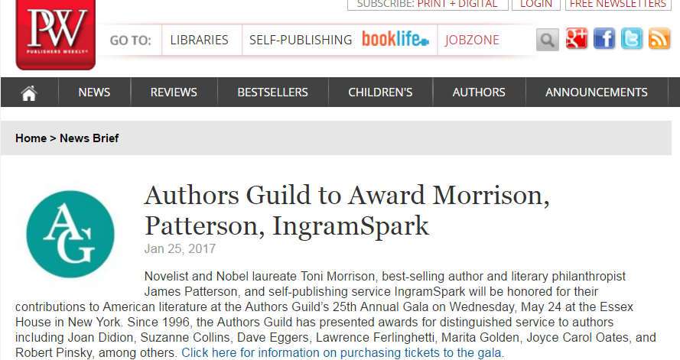

Notes:
General content slide

Slide 23
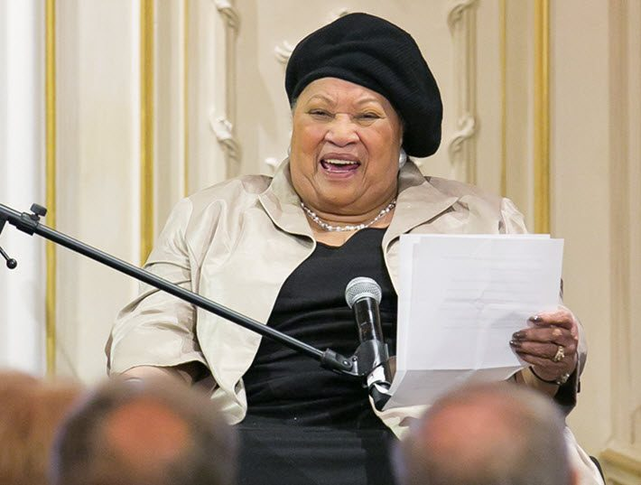
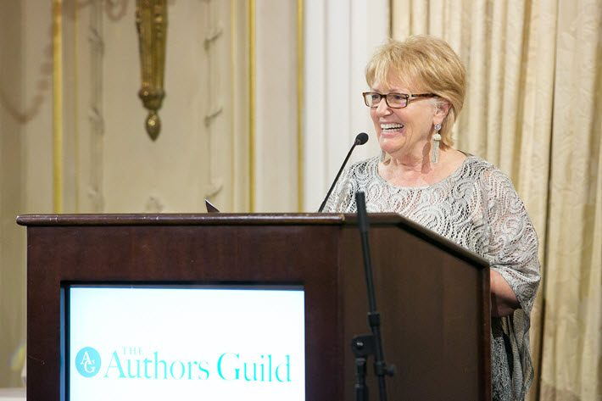
That’s me with Toni Morrison
Notes:
General content slide

Slide 24
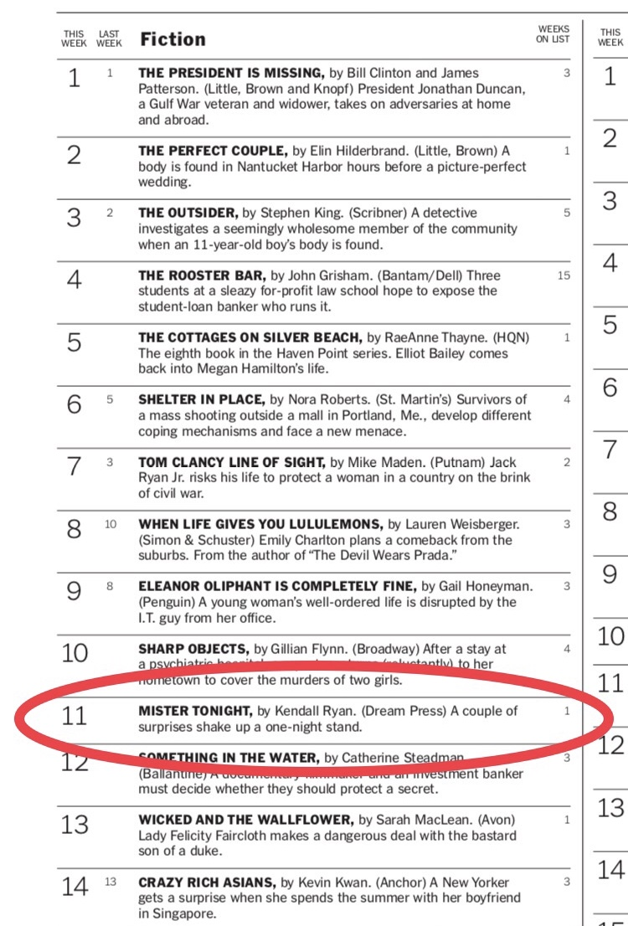
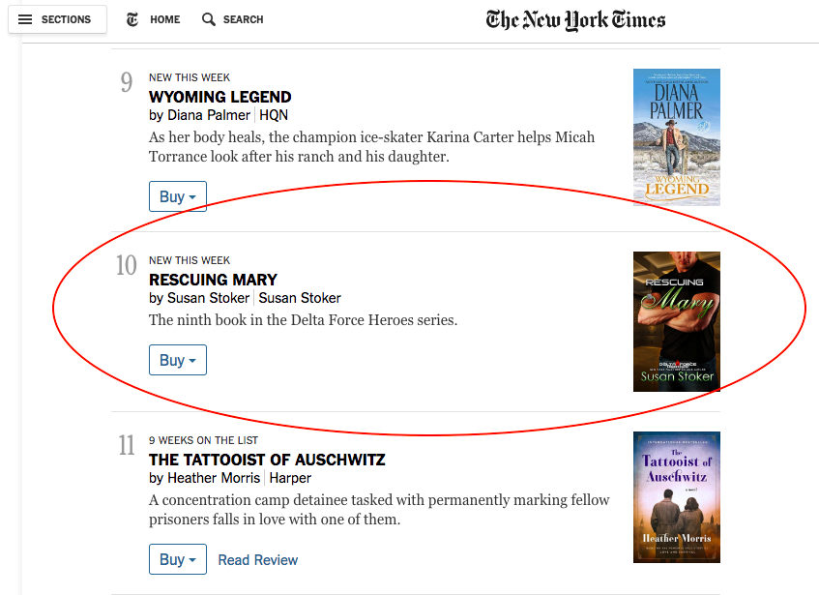
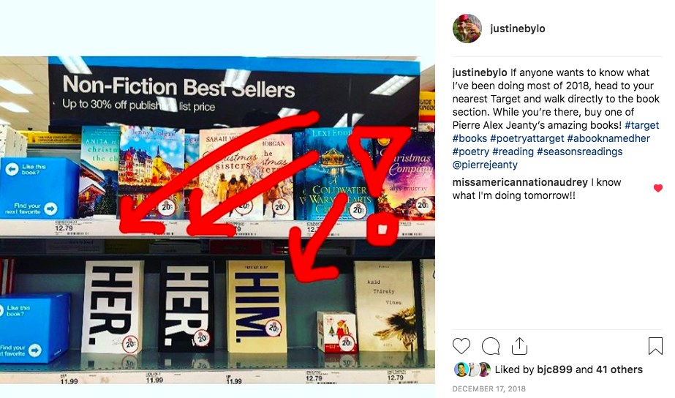
IngramSpark 2019 Accomplishments
4 Books on
Target Shelves!
2 NY Times
Bestsellers!
Notes:
General content slide

Slide 25
How it Works
You setup your FINISHED book
Provide book metadata
Upload final digital files for P&E; P-only or E-only
Or use our Book Building Tool to format your book
You get an e-proof—order a print copy
Notes:
General content slide

Slide 26
How it Works
Enable Distribution
Publisher Direct Orders--Manufactured in US, UK, AU and drop shipped wherever you want
You pay for printing, shipping, taxes at time of order
Orders from our Trade partners--We receive order and manufacture and ship
You are paid for these orders 90 days later
Notes:
General content slide

Slide 27
Things to Get Right Before Publishing
Do your market research on your topic
Know your reader/audience
Have a budget that you can afford
Work with professionals: editors; designer, marketers
Test drive the TITLE – original, memorable, relevant, unique.
Provide a clear idea for cover design.
Perfect the blurb – the all-important 150 words!
Get endorsements
Be interesting as an author/build your brand--photo/bio
Be social on social
Notes:
General content slide

Slide 28
Retail Price and Wholesale Discount
Know the print cost for your book. You will also need this information when deciding on the retail price.
Use the online Publisher Compensation Calculator located under TOOLS at www.ingramspark.com
Example:
$20 Retail price
-53% wholesale discount (Your choice between 30-55% off retail price—this
includes Ingram’s cut as the wholesaler)
$9.40 what the retailer pays us for the book)
-$4.81 Print cost for 300 page 6x9 paperback
$4.59 Compensation paid to you approximately 90 days later
Notes:
General content slide

Slide 29
Invest in Editing
1st Stage of Editing
Beta Readers
Writing Groups
Online Workshops
Your Mom
2nd Stage –Developmental Editor
Plot Help
Character Development
Setting
Voice
3rd Stage of Editing- Copy Editor
Grammar
Spelling
Punctuation
Fact-checking
Last Stage of Editing- Proofreader
Hire AFTER your edits are done
Catches any missed mistakes- grammar, spelling, punctuation and formatting
Read out loud
Notes:
General content slide

Slide 30
Invest in Book Design
Make it beautiful and/or interesting
Follow standard book organization of the interior and cover
Test the design alongside other books
Design has to work large and small (very small online)
Plan to spend $500+ to $5K for original illustration
Front cover should make someone pick it up
Back cover should make someone take it to the cash register
  Endorsements, blurbs, author bio, pricing, barcode
  Don’t forget the design of the spine
Notes:
General content slide

Slide 31




Cover Design—Good Examples
Notes:
General content slide

Slide 32
Invest in Marketing--DIY or Hire
The Author Platform
Build your profile online and in person
Have a website—collect email addresses
  Sample chapters/Giveaways/Point of Sale
Create a blog - and keep it updated
Use social media (FB, twitter, YouTube, Instagram)
Associations; Networking; Conferences
Media exposure; pre- and post-publication
Review copies and Award submissions
Book launch
Notes:
General content slide

Slide 33
METADATA needed for distribution
Title--concise, unique
Robust description, starting with a pitch
Author/contributors on the cover—make sure they match
Most specific subject categories BISAC/Thema
Format (paperback, hardcover, eBook)
Series: Use it if you have it
Keywords should be relevant and non-fluff; 7-11 words or phrase; consumer-focused used for search; not on the screen
Imprint (Publisher) Name
Notes:
General content slide

Slide 34
METADATA to help you sell
Author Biography, affiliations, location
Reviews, endorsements, TOC
Audience (Adult, YA, JUV—age, grade)
ISBN’s (own your own)
Pricing in Global Markets (US, UK, EU, CA, AU)
Print Attributes (size, # pages, paper color)
Retail Discount and Returnability (nonreturnable, return-deliver, return-destroy)
Publication Date and On Sale Date - Preorders
Notes:
General content slide

Slide 35
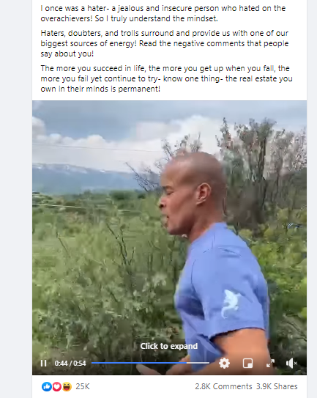
Indie Author Success
David Goggins
Retired Navy Seal, Endurance Athlete, Inspiration
700k followers on FB
Created demand and then started marketing
Notes:
General content slide

Slide 36



Indie Publishing/Libraries and Booksellers
Notes:
General content slide

Slide 37
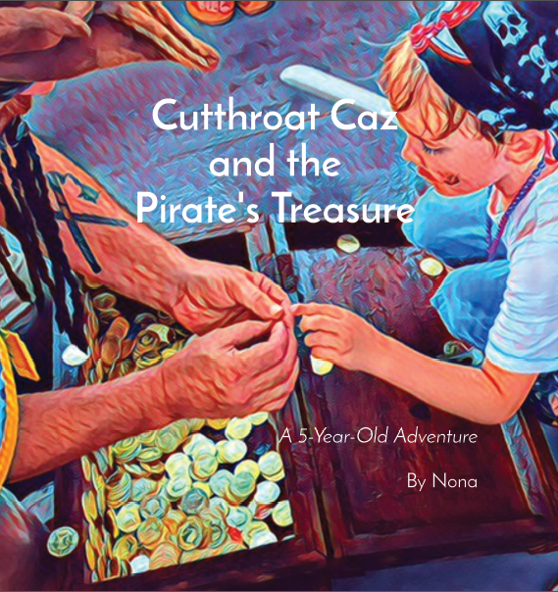
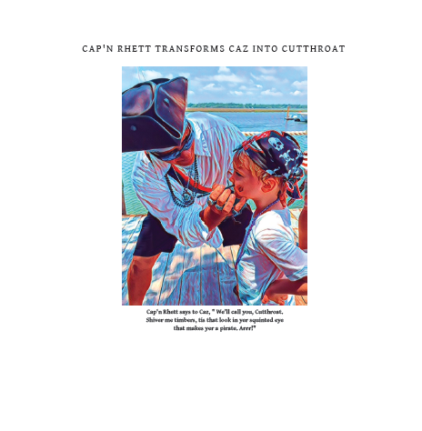
Indie Publishing/For fun
Party Hardy Storybooks
Notes:
General content slide

Slide 38
Book Building Tool
It’s New and It’s Free
Notes:
Presentation title slide

Slide 39
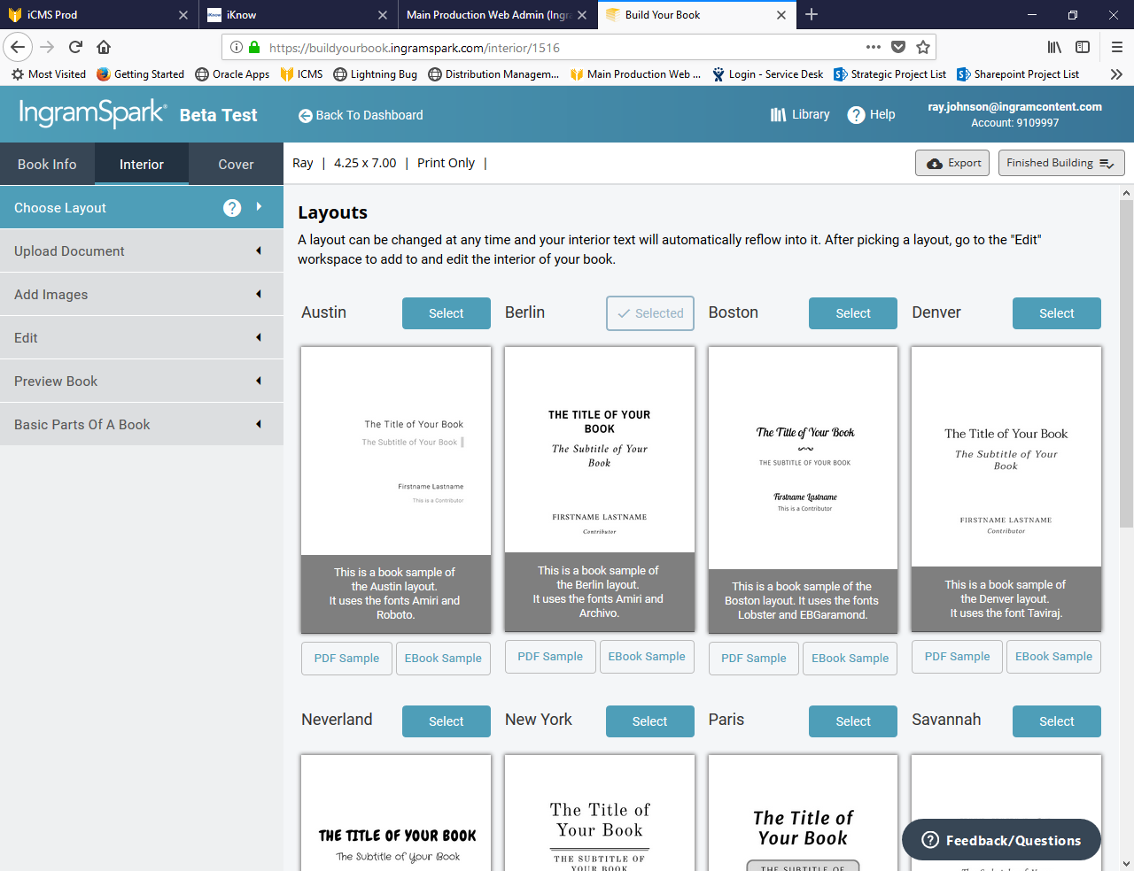
Build
Your Interior
Choose Your Layout

Slide 40
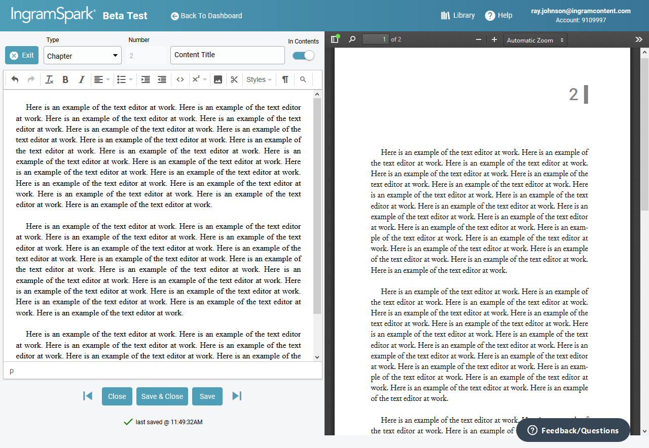
Build
Your Interior
Use Our
Text Editor

Slide 41
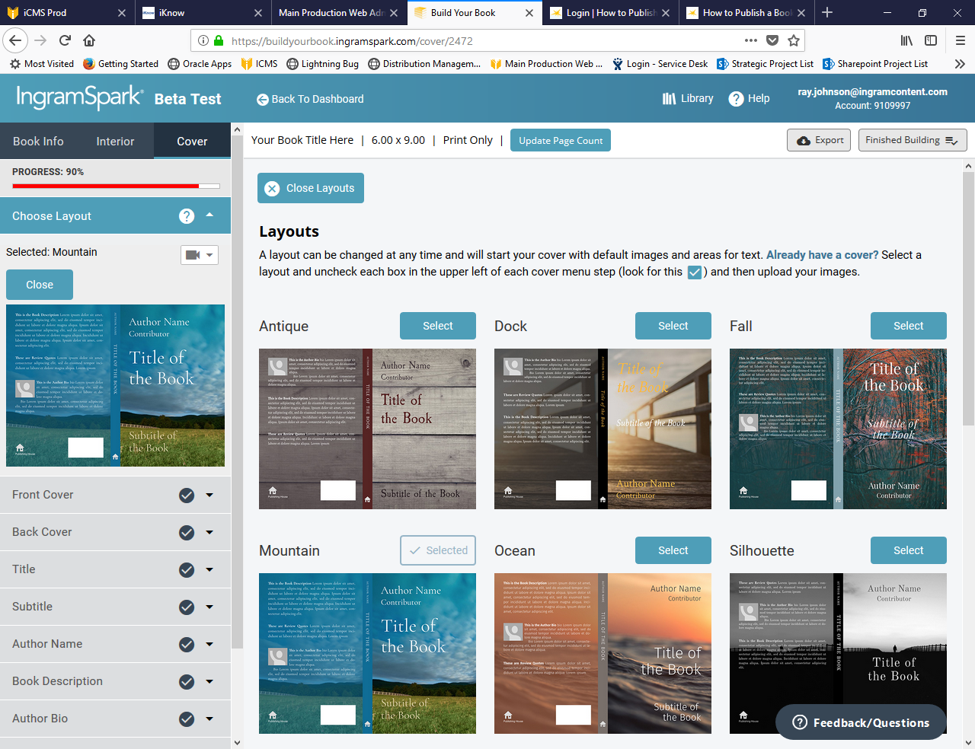
Build
Your Cover
Choose a Layout

Slide 42
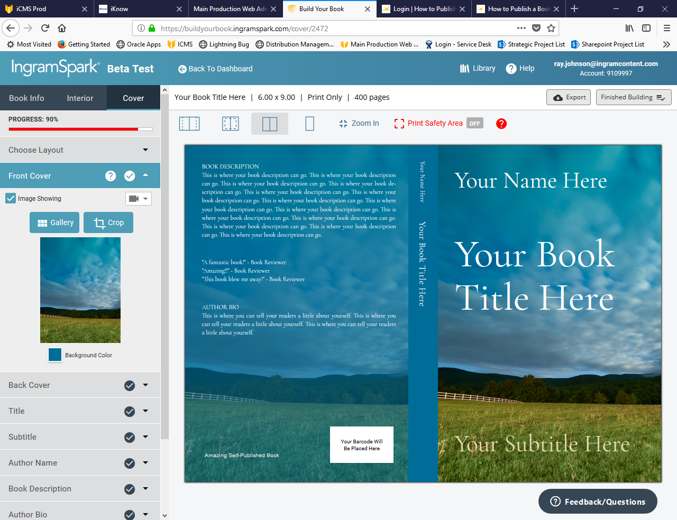
Build
Your Cover
You’re in control

Slide 43
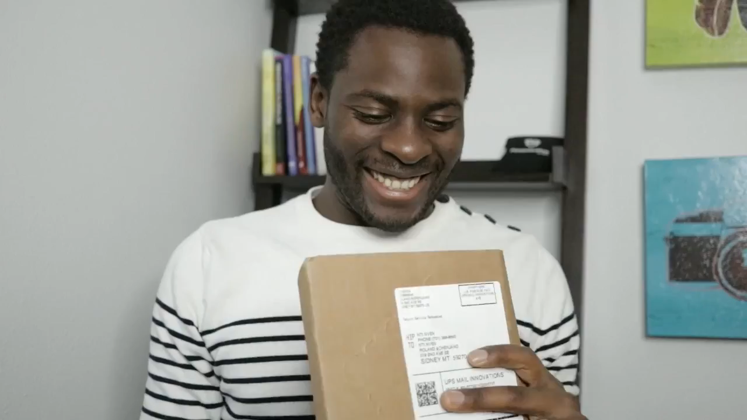


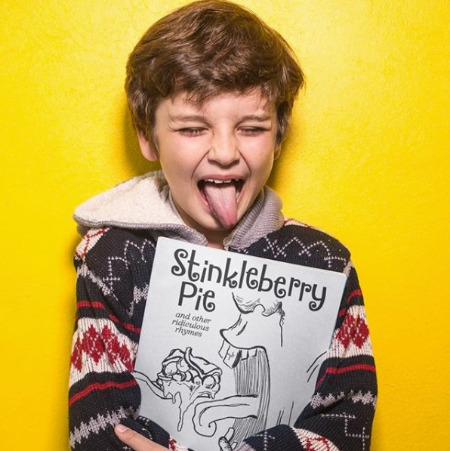
Let’s Get Social
Follow us on social media and tag us
IngramSpark Day photos & videos!
Instagram: @IngramSparkBooks
Facebook & Twitter: @IngramSpark
Use our hashtag #IngramSparkAuthor
#SparkUnboxing
Notes:
General content slide

Slide 44
“A Dream Manifested”
“Be Great! Because that’s who you are”
Notes:
Presentation title slide

Slide 45
Free Title Setup
Through December 31, 2020
Use Code SPARKUS
Follow and Like us
IngramSpark

Slide 46




Connect with Us
www.ingramspark.com
Follow IngramSpark
#ingramspark
#ingramsparkauthor
#ingramsparkbooks
#SparkUnboxing
Notes:
Final presentation slide

Slide 47

Contact and Follow Robin
Email: robin.cutler@ingramcontent.com
@rcutlerbookpub
Go Publish Yourself
Notes:
Presenter slide

